Slide 1

Project Report Presentation on Text and Voice based Chatbot for Websites
By:
Kumar Nilind (189301121)
Shubham Maheshwari (189301129)

Slide 2

What is a Chatbot? What is the purpose of a Chatbot?
A Chatbot is a computer program that simulates and processes human conversation (either written or spoken), allowing humans to interact with digital devices as if they were communicating with a real person.
Chatbots are used in various fields for entertainment, security, customer support or even in gaming.
Generally, chatbots are used by businesses and organizations in order to provide basic but fast customer care response to their customers. Although, there are many other fields where Chatbot is used, currently the main usage is in the field a customer care for providing customer support in websites navigation/ business related information.

Slide 3

Target Audience of the Project
The Chatbot is developed for small business or businesses that are new in the field of chatbots for their products. These businesses generally lack data and resources required to develop and run a chatbot.
The Chatbot developed in this Project requires very less data compared to advanced chatbots and requires very less time to develop and deploy. The Chatbot requires only the data of the business related queries and a website for deployment.
So the Project requires very less in terms of data, and therefore a decent candidate for small businesses. Although, it still requires slightly more resources to work and more developer effort than AI based chatbots and is comparably more basic and rigid in terms of conversation flow.

Slide 4
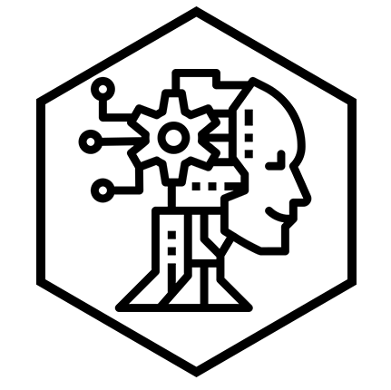

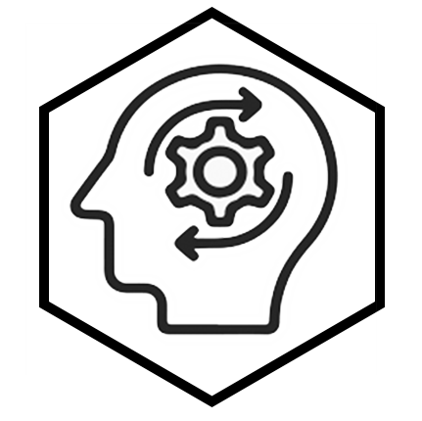
Approaches in developing a Chatbot
AI Based Approach (Not Used)
Uses complex Deep Learning and Machine Learning Algorithms to Generate their own Responses.
Used in General Purpose Conversations.
Example: Alexa, Siri, Cortana
Rule Based Approach (Used)
Uses simple programming rules to select specific preloaded responses.
Used in Business Specific environments with strict conversation flow.
Example: ELIZA
Hybrid Approach (Used)
Uses best of both approaches with a some downsides of both are well
Used in special cases.
Example: Medical Diagnosis Assistants

Slide 5
Rule based approach:
This approach uses pattern matching, regular expressions and basic NLP in order to produce a response. This approach is for narrower conversation flows where the user might ask for response from a small set of possibilities.
Therefore, it needs only the data regarding various intentions of the user that Chatbot needs to respond to and no processing is involved in generating a model as a computer generated model is not required. In this approach, the developer has to create a set of patterns for each possible query of the chatbot. This is an ideal approach to our target audience, but requires a lot of manually created patterns for the chatbot to work with.

Slide 6
Hybrid approach:
This is a unique approach which mixes the right amount of both AI and Rule based approaches. It takes the pros of AI based approach of having flexibility and less rigid conversation flow and the pros of Rule based approach of requiring a lot less data. Hybrid Approach can be applied in many ways, like using supervised Machine Learning algorithms to classify inputs into a small set of outputs or using pretrained Neural Network models to classify patterns similar to a given pattern. Although this also brings in a few cons of both approaches like it requires more developer efforts and more processing power to train ML based models. This approach is ideal for our Target Audience as it needs almost no data and less resources compared to AI based approach.

Slide 7

Advantages of approaches used in this project
This Project will use the Rule based and Hybrid approach benefits of this are:
Well defined flow of conversation and very less chances of failure.
Data pre-processing is very less.
No huge storage is required for storing data.
Can provide responses even if the input slightly out of chatbot’s vocabulary using classification.
User-friendly and easy to use.
Reasonable response time.
Multiple approaches helps fulfil various requirements of the business.

Slide 8
However, there are also certain fallbacks to this approach:
It cannot handle completely new queries or queries which the chatbot is not supposed to work with and are not classified in the query database and all such queries are classified as out of scope.
Self learning can be used to fix the previous fallback but this requires manual filtering of user data by a person as the user may provide incorrect response due to some error.
Chatbot can become slow and require a lot of memory as the dataset becomes larger.

Slide 9

Features of the Chatbot
Chatbot will be able to converse in the defined flow of conversation with human-like responses.
Chatbot can use Text or Voice based input in order to reply to a user query.
Chatbot will be usable and deployable for Websites.
Data collection for Self-Learning can be implemented by recording the user inputs and responses in a SQLite3 database table.
Can use custom user defined queries provided in an excel sheet for identifying business specific keywords and responses.
If the user wants to communicate to the company, they can also save the data in a separate table.
Chatbot also supports a few common built in intents like Greetings, Confirmations, Goodbye etc.

Slide 10
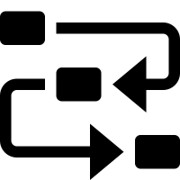
Methodologies used in our project
The chatbot has multiple functionalities for Pattern Matching and ANN based approach, for smaller more specific datasets containing only keywords it is recommended to use Pattern Matching and for Sentence based input it is better to have ANN.
Data is firstly pre-processed for building a model for the chatbot, whether for Pattern matching (building the database) or whether for ANN (training the network on the dataset)
Pre-processing includes:
Tokenization: Conversion of sentences into words and removal of extra characters like stop words and punctuation. This is done using NLTK library.
Lemmatization: Conversion of similar words into one common word, for example have and having are both converted to have. There is also a similar faster approach called stemming, however stemming doesn’t save the meaning of the word itself. Therefore, only lemmatization is implemented. Eg:
Lemmatization: have, having -> have, have
Stemming: have, having -> hav, hav
WordNet: After getting one word for the sentences we pattern match them, but in order to give more flexibility to the user for inputs, we also find synonyms of words, or just similar words from the collection of words called WordNet, available in NLTK library, all the similar words are then matched with the input from the user.

Slide 11
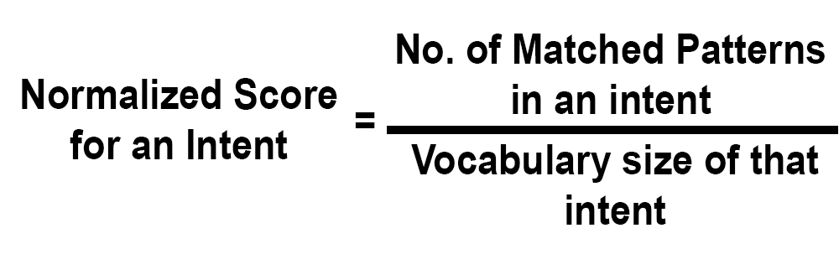
After pre-processing is done and the data is saved. The models are prepared and the Chatbot is ready for its inputs.
Normalization:
Pattern Matching System works on the approach of matching certain keywords in the query with the dataset, the number of matched patterns are normalized by dividing the number of patterns present in the dataset.
For Artificial Neural Networks,
We are using Fully connected input layer with 1 hidden layer to classify the intents. The number of epochs for training the models and the number of neurons present in the hidden layer can be changed as per the requirements. For training of neural network we require inputs in the form of matrices. The dataset in this case is also analysed to create a bag of words model. Since we have made the chatbot for relatively small data, it is unfeasible to vectorize it with other much complex algorithms like TF-IDF, CBOW or Skip-gram. The bag of words model analyses the data and counts the total number of unique words that occur in the dataset.

Slide 12
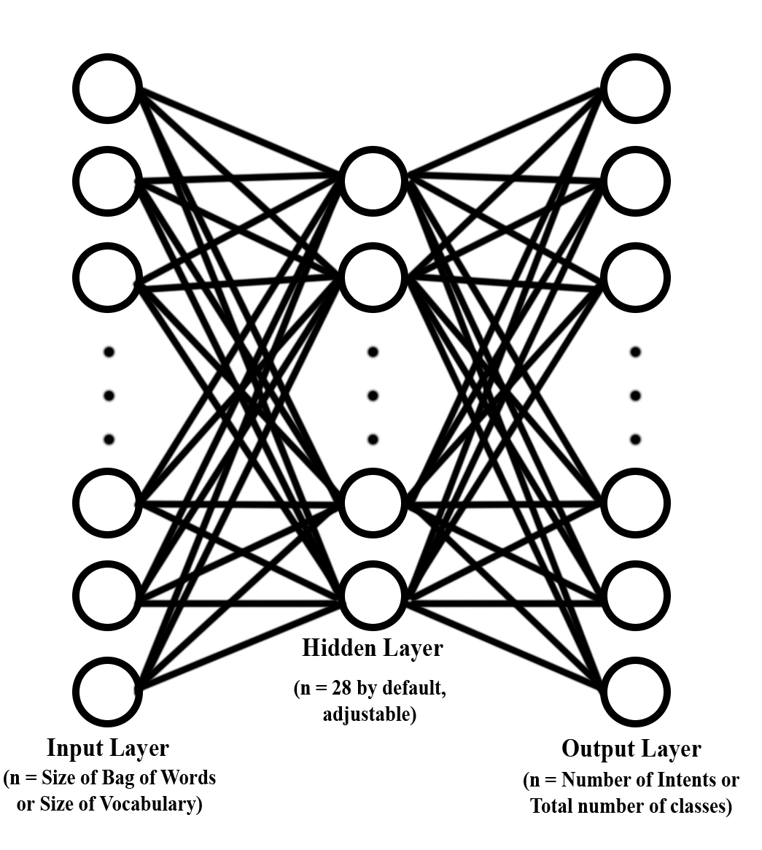
Neural Network Architecture used in the Project:

Slide 13
Bag of Words Approach:
The number of words in the dataset are saved and the words are saved in the form of list of vocabulary. After this, each sentence is then converted into a vector by first creating a vector of length of the vocabulary with all 0’s. Then each word of the sentence is check and the index at which the word matches in the list of vocabulary is incremented by one in the vector. For example:
Say we have two sentences,
This is a queen.
That is the king.
So the vocabulary of this dataset will be:
[this, is, a, queen, that, the, king]
So the vector representation of Sentence one would be:
[1,1,1,1,0,0,0]
And for sentence two:
[0,1,0,0,1,1,1]

Slide 14
The Chatbot also features a self learning system and saving system for contacts,
Self Learning System: To implement self learning we need to collect data, and for collection of data we need user input. The self-learning system for this chatbot is developed such that the queries that are out of scope for the chatbot can be saved in a database. The user can also participate in providing an appropriate input for that data. This database can be accessed by the admin of the website who can check the responses whether they are appropriate for that chatbot and either save or delete them from the database. If the responses are saved then they are added to the dataset which can then be used by the chatbot.
Contacts/Information Saving: The Chatbot also has a feature to save the customer contact details which can be used to subscribe to a newsletter or to contact the authorities that run the website. It works in a similar way as the self learning system, except the row can’t be saved into dataset.

Slide 15
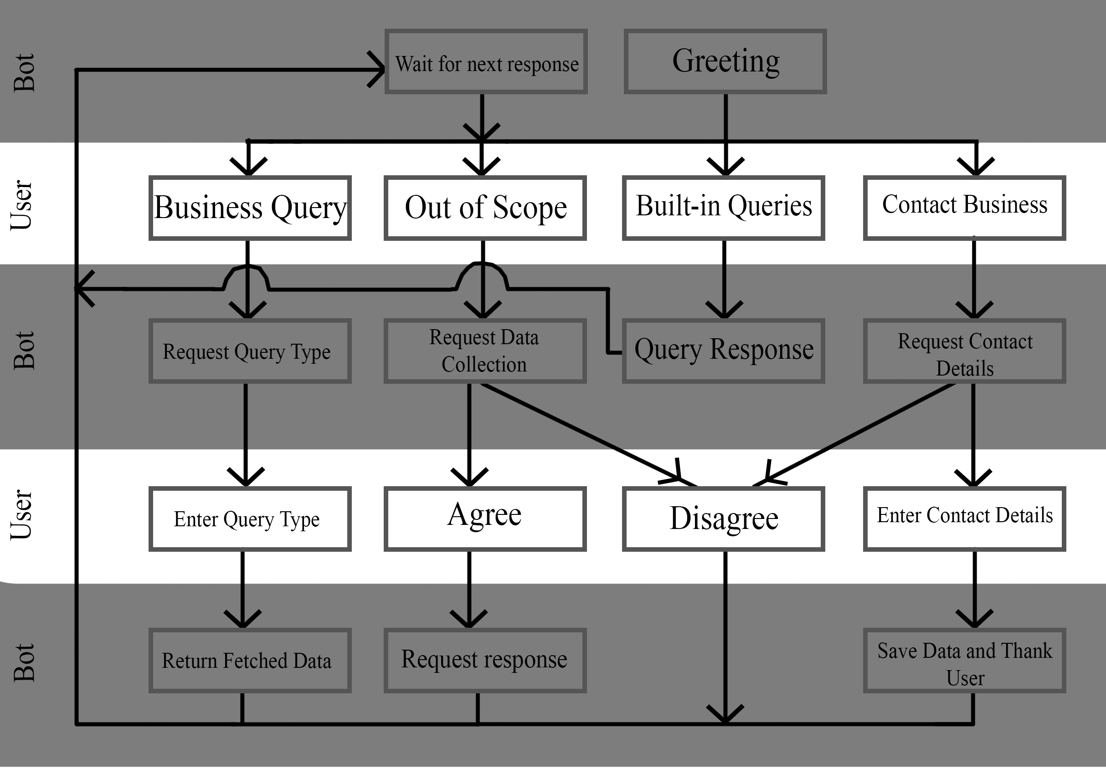
Conversation flow of some basic input classes

Slide 16
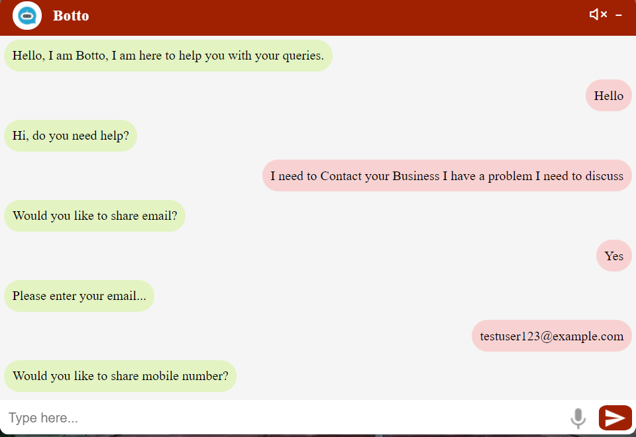
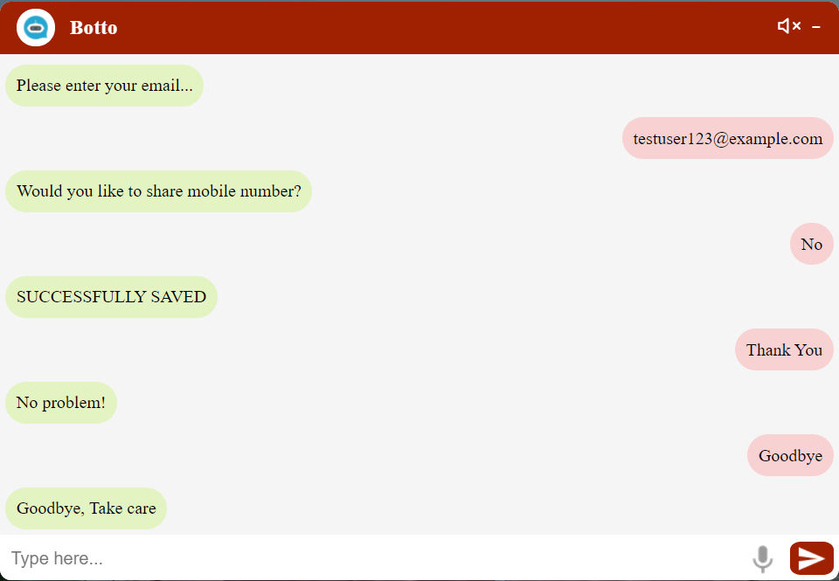
Sample Conversation

Slide 17
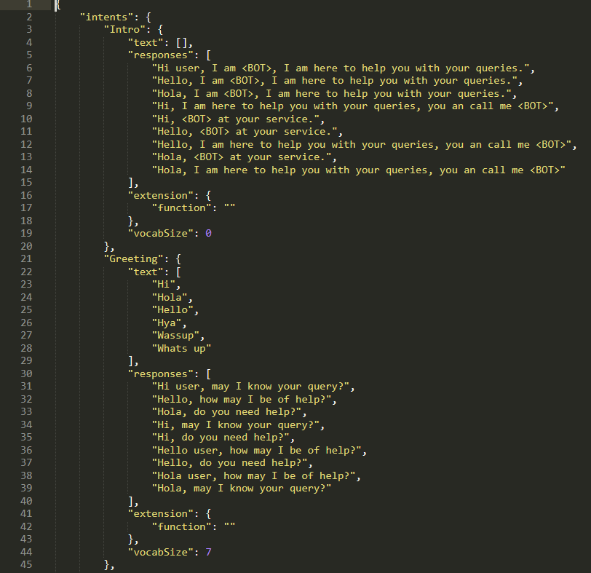
Dataset Format Screenshot

Slide 18
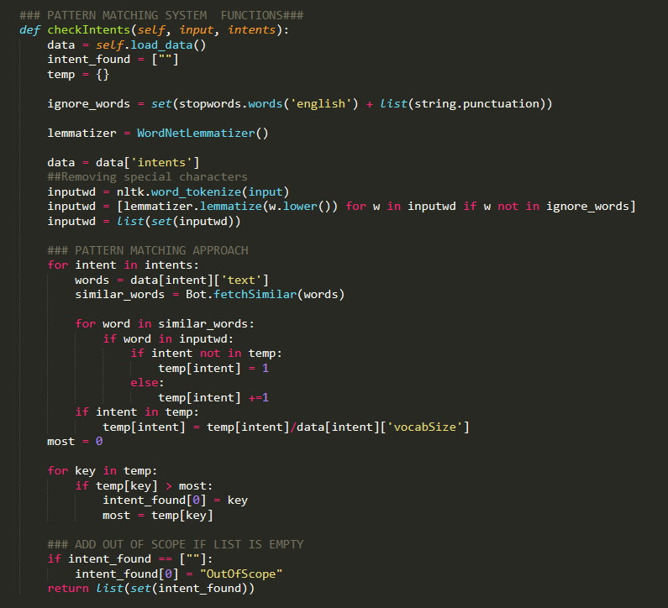
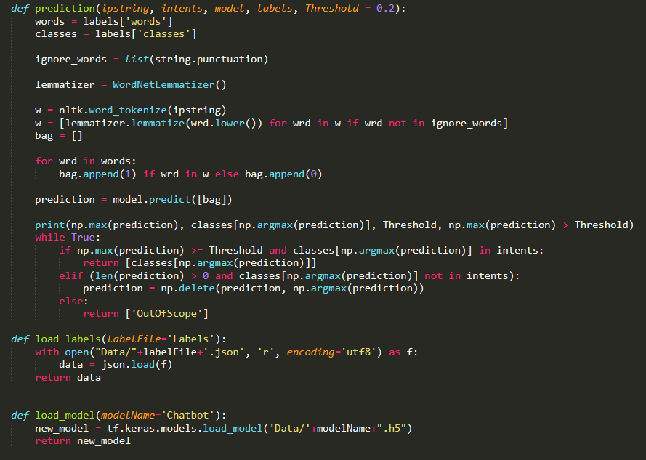
Screenshots of snippets of Source Code

Slide 19

Conclusion and Future development
This Chatbot can be used as a good starting point for any business/organization with low amount of data and resources.
This Chatbot can further be used to data collection for a business until the business or organization has collected enough for implementing a AI based chatbot.
Various Supervised Machine Learning Algorithms can be used to bring more flexibility in the conversation flow of the chatbot.
Various other systems like, Sentiment Analysis and Natural Language Generation with enough data can be applied.

Slide 20
Thank You

